Slide 1
Lecture 3: Random number generation

Slide 2
Pseudorandom numbers
Pseudo Random Number Generators:
Create random numbers using a mathematical algorithm
Classical examples: Congruential generators
Come as embedded functions in software or can be linked as separate objects to the program code.
The numbers are not truly random; attention must be made to the type of application.

Slide 3
First step: Generating U[0,1]
Linear congruential generator
Define a sequence {x_{k} } of integers according to
where x₀ is called seed , “mod m” means that x_{k} is the remainder after division by m
The result is an integer in the interval [0, m – 1]
a and c are constants in [0, m), need to be carefully selected
To obtain U[0,1] , x_{i} are scaled, i.e.
x_{i}:= x_{i}/m

Slide 4
First step: Generating U[0,1]
Generated numbers will get into a “loop” with a certain period
Example:
Let x₀ = a = c = 7 and m = 10
➔
The period is thus 4 in this case

Slide 5
First step: Generating U[0,1]
Comments:
Obviously, period can not be larger than m
Period and other constants should be carefully chosen, m is typically very large
Seed defines the sequence of random numbers, if seed is fixed by program – same sequence will be produced
Other methods for generating U[0,1] are available (i.e. generalized feedback shift register)

Slide 6
Generation U[a,b]
U(0,1) can be transformed to U(a, b):
U can also be transformed to discrete uniform distribution on the integers (1, …, n ) by
where [⋅] depicts the integer part.
Question and exercise:
Why do we need to add “1”?
How can U be transformed to a random variable Y with a discrete uniform distribution on the integers (50, 55, 60) ?

Slide 7
Generation of nonuniform random numbers
U(0,1)
Let U be a random variable uniformly distributed on (0,1)
Let F_{U} be its cumulative distribution function, i.e.
The probability density function (pdf) of U is

Slide 8
Inverse CDF method
Let X be a random variable with CDF F_{X} .
Set where U is U(0,1)
The CDF of Y is now
as 0 ≤ F_{X} (y) ≤ 1 and F_{U} (u) = u for 0 ≤ u ≤ 1
➔ Y has the same probability distribution as X !

Slide 9
Inverse CDF method
If U is U(0,1) then a realization of a random variable X with CDF F_{X} can be obtained by
provided F_{X}⁻¹ can be evaluated
The realization U comes from a RNG

Slide 10
Inverse CDF method
Example
Let X be exponentially distributed, i.e. with pdf
➔
for x ≥ 0 [F_{X} (x) = 0 for x < 0]

Slide 11
Inverse CDF method
Example(cont.)
To find F_{X}⁻¹ solve for x the equation
Thus the transform from U to X becomes

Slide 12
Inverse CDF method
Inverse CDF method – discrete variables
Define distribution P(X=x_{i})=p_{i}
Generate U from U(0,1)
If U≤p₀, deliver X=x₀
If U≤p₀+ p₁, deliver X=x₁
…
Repeat procedure from step 2

Slide 13
Inverse CDF method
When the inverse cumulative distribution can be explicitly derived ➔ No problem!
When not ➔ Numerical solution necessary ➔ Usually time-consuming
Unfortunately, situation 2 is quite typical, ex.: normally distributed random variables

Slide 14
Generating N(0,1)
Assume
Θ ε U(0, 2π)
D ε U(0,1)
Algorithm 1
Generate D and Θ
Generate X₁ and X₂ as
X₁ and X₂ are independent and normally distributed (see proof…)

Slide 15
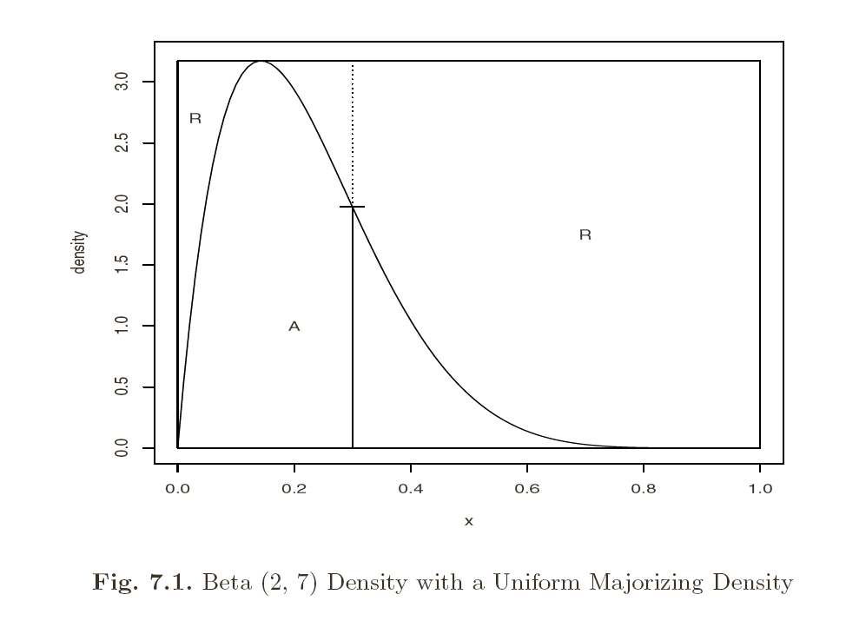
Acceptance/rejection methods
Idea: to generate Y with PDF f_{y} similar to some known PDF f_{x}
Requirement: There should exist constant c such that
f_{Y}(x) majorizing density,
proposal density
f_{X}(x) target density
c majorizing constant

Slide 16
Acceptance/rejection methods
Algorithm
Generate Y from distribution with density f_{Y}
Generate U from U(0,1)
If , take Y else return to step 2
It can be seen that variables obtained are from f_{X}
Larger c lead to larger rejection rates R
The value of c should be as small as possible (minimize R)
The method works for multivariate random cases, but the rejection proportion can be high (curse of dimensionality)

Slide 17
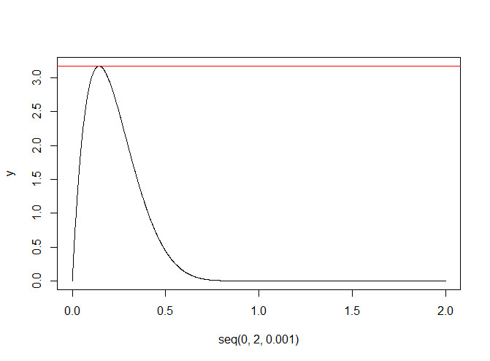
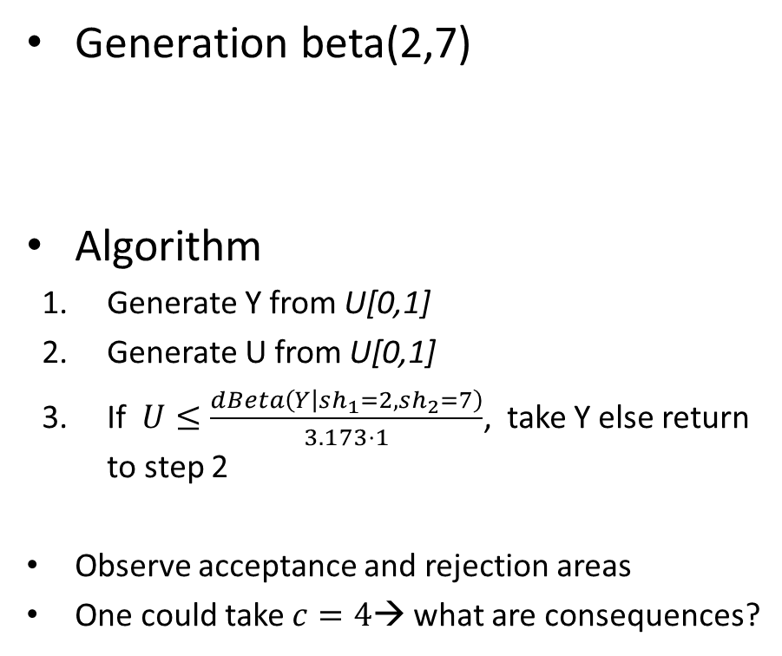
Acceptance/rejection methods
Generation beta(2,7)
Algorithm
Generate Y from U[0,1]
Generate U from U[0,1]
If $U≤\frac{dBeta\left(Y | sh_{1}=2,sh_{2}=7\right)}{3.173⋅1}$, take Y else return to step 2
Observe acceptance and rejection areas
One could take $c=4$→ what are consequences?
> y=dbeta(seq(0,2,0.001), 2,7)
> max(y)
[1] 3.172554

Slide 18
Generating multivariate normal
Acceptance/rejection is difficult to apply
Difficult to determine majorizing density
High rejection rate
Suppose we need to generate N(μ,Σ):
Take i.i.d. N(0,1) sequence X=(X₁,…X_{n})
Compute Cholesky factor or matrix square root, i.e. matrix A: AA^{T}= Σ
Compute Y as μ+AX
Observe: EY= μ, cov(Y)=AA^{T}

Slide 19
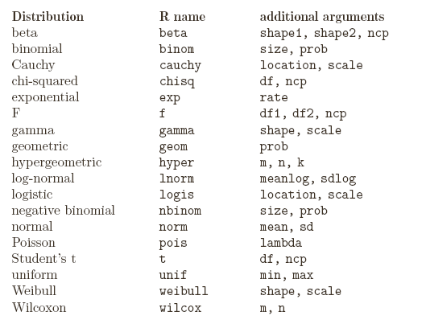
Random numbers in R
Use d for density p for CDF q for quantiles and r for simulation:
(ex: rnorm pnorm dnorm qnorm)

Slide 20
Recommended reading
Chapter 7.1-7.3

